Slide 1
AIR-STRIKE
Aerial Intruder Removal - System for Tracking and Rendering Ineffective Knavish Enemies
Group 13
Kevin Chau - Computer Engineering
Scott Greenwald - Electrical Engineering
Andrew Kirk - Photonics Engineering
Christopher Walls - Computer Engineering

Slide 2
Motivation
Team motivation stems from several factors
  Proposed system contains several subsystems which coincide nicely with our individual interests
  Work involved utilizes each of our skill sets and will enable us to learn more about our favoured subjects
  Prvious internships/CWEP with Lockheed Martin
    Worked on similar systems
  Overall chance to develop and improve our engineering skill and judgement

Slide 3

Goals and Objectives
Develop a autonomous surface-to-air turret defense system
Utilize directed energy systems to neutralize targets
Maintain reliability, precision and safety throughout the process
Perform all computation without external computers

Slide 4
Specifications & Requirements
The detection rate of a target in the field of view shall be at least 70%
The system shall be capable of tracking a single target
The system shall be able to neutralize a target within ten feet
Upon detection, time to first kill shall be 7 seconds
The total field of view shall be approx. 75°
The directed energy system shall deliver at least 100 mW of power in a concentrated beam
The mounted laser should be capable of movement 120° azimuthal (60° each direction) and 120° elevational (60° each direction)
The system shall be interfaceable through USB or wireless signals by external devices

Slide 5
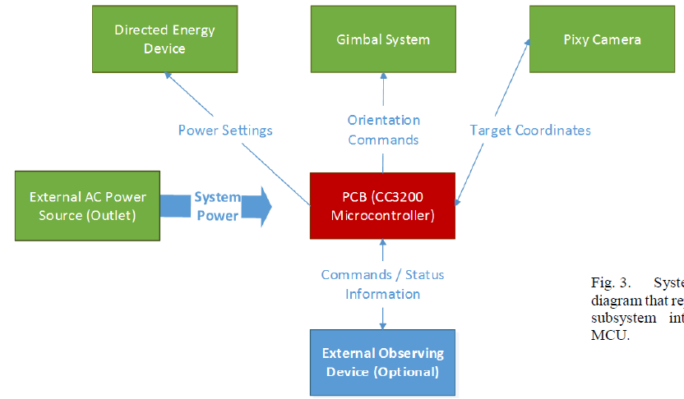
Overall Control System Design

Slide 6
Microcontroller

Slide 7
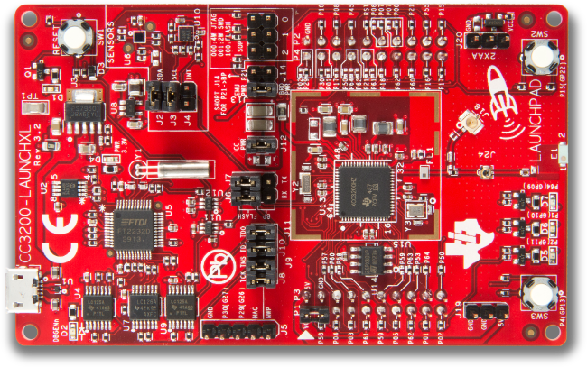
Microcontroller – CC3200
Able to interface with required peripherals.
  1 Pixy camera - SPI
  2 Servos - PWM
  1 Laser Driver - PWM
  USB
Network processor and MCU in one package.

Slide 8
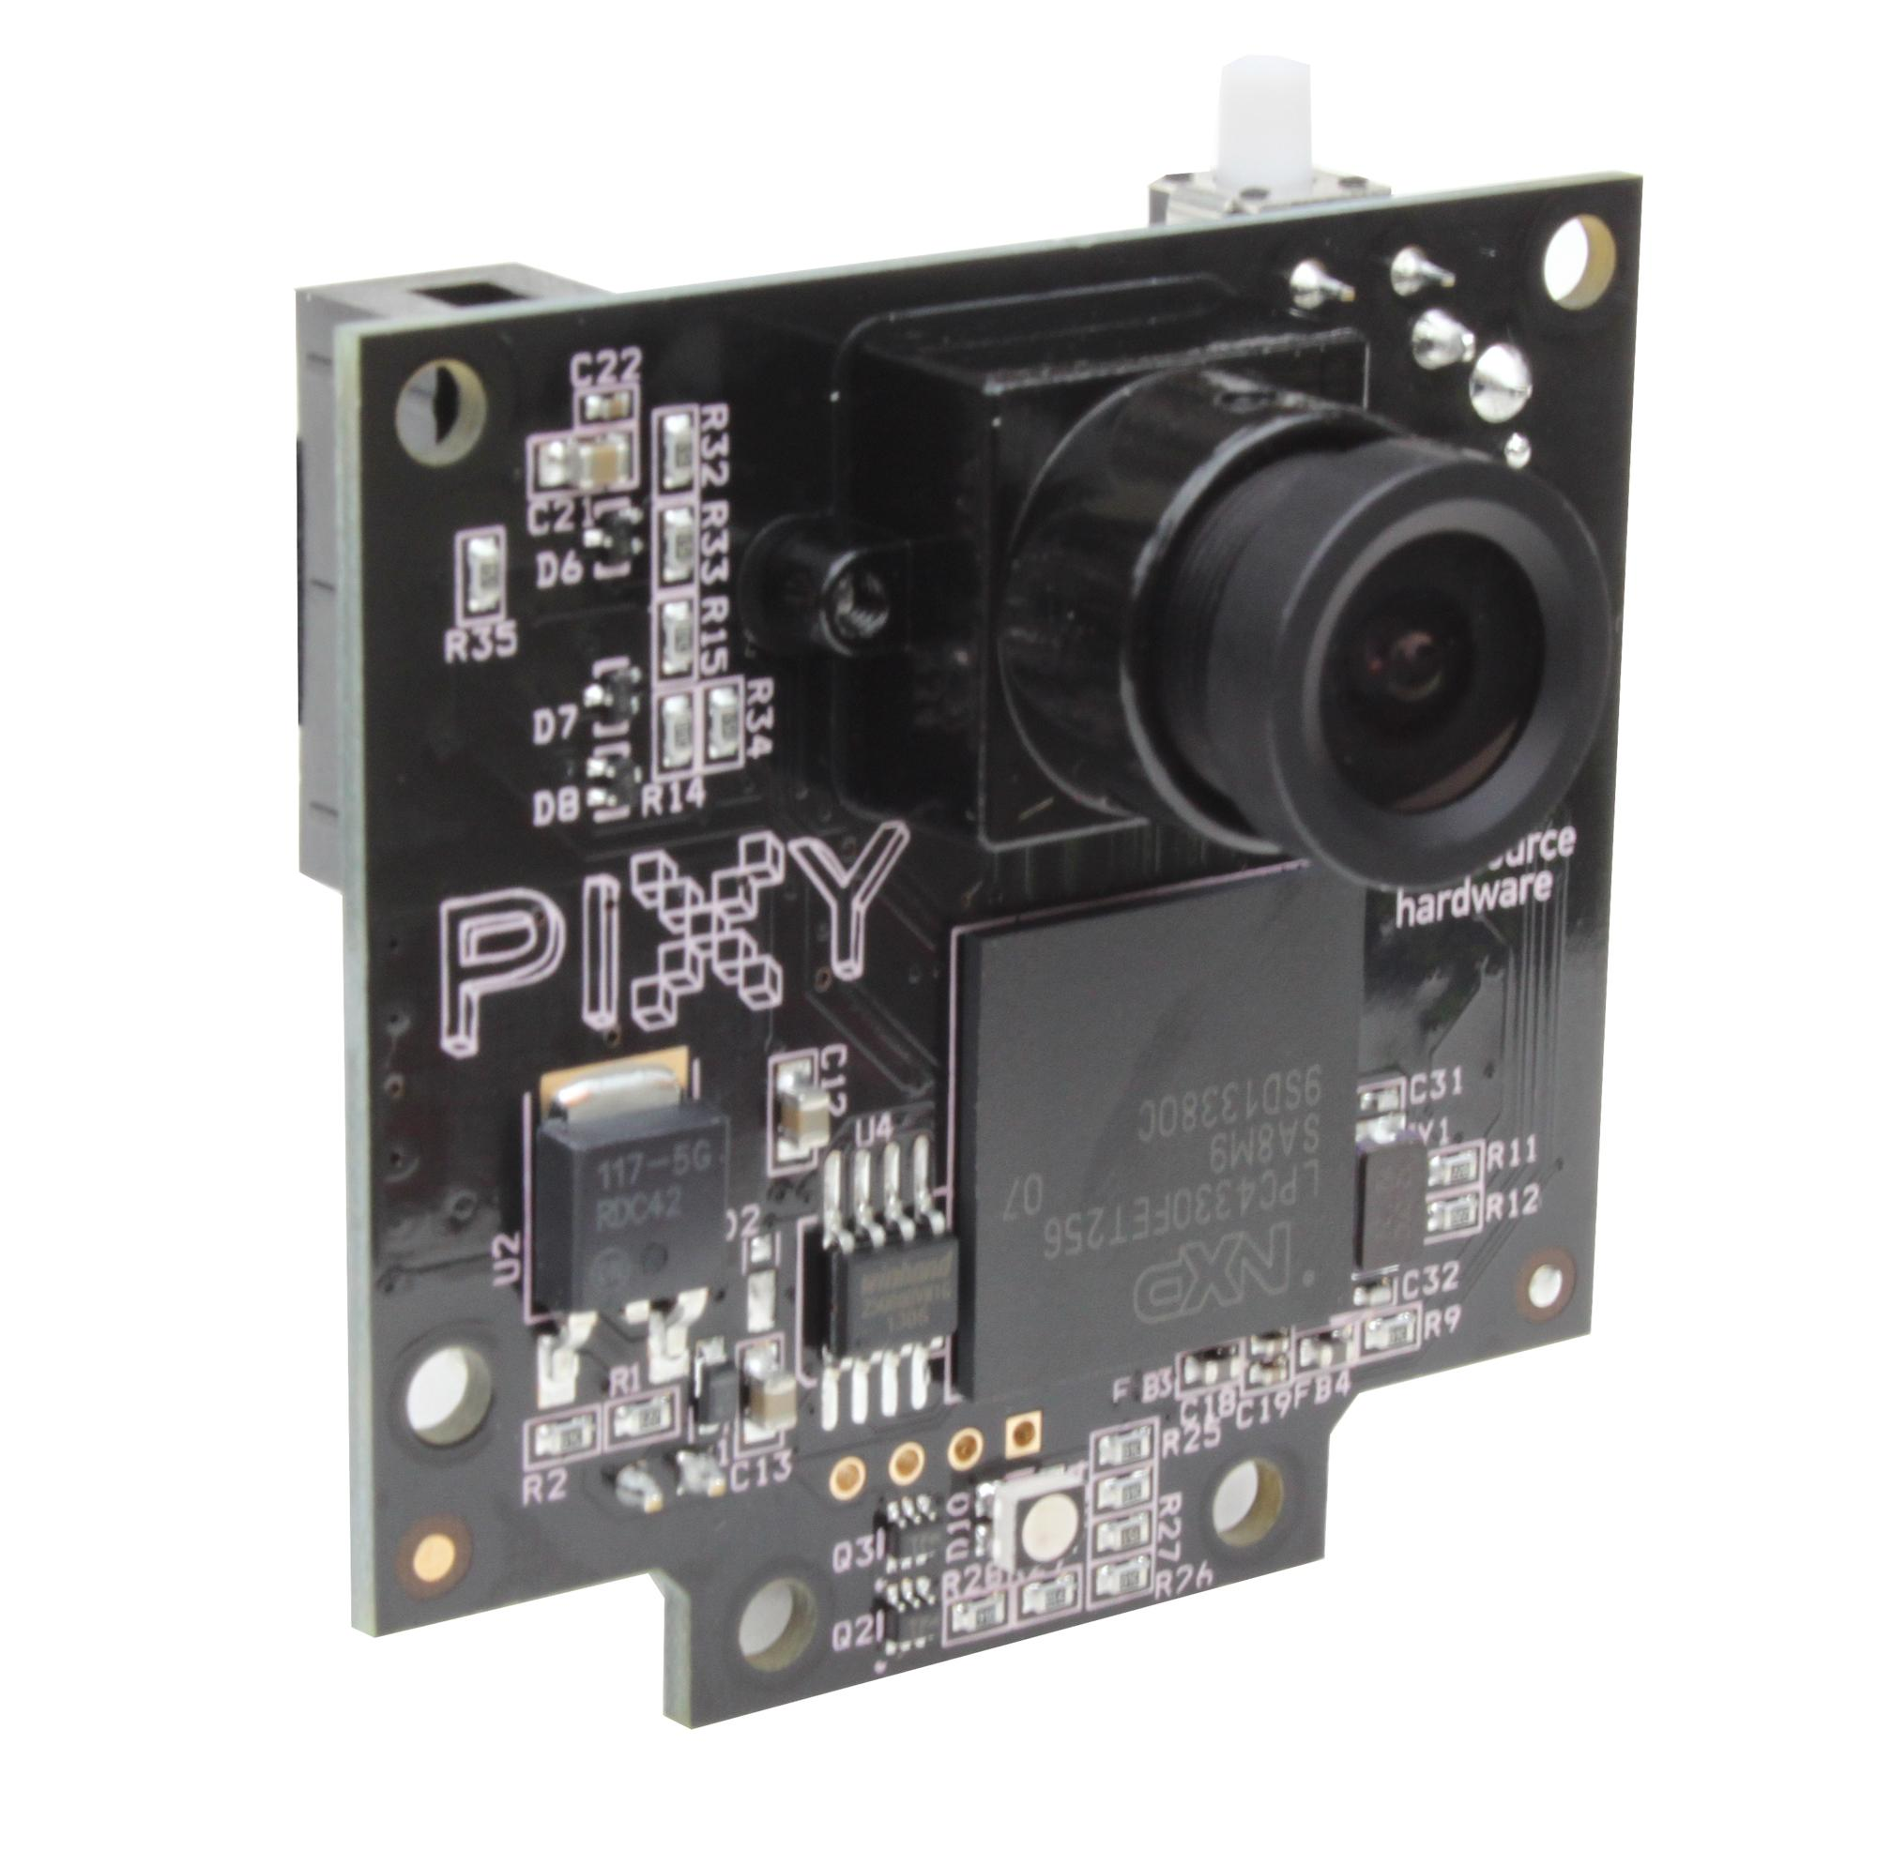
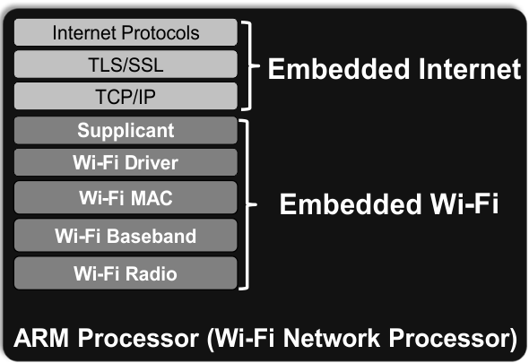
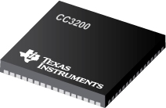
Microcontroller - Divide and Conquer
Offload intensive processes off the main MCU
Target Identification
Master Control
Network Processor

Slide 9
Software

Slide 10
Software Architecture
SimpleLink (Highest Priority)
Designed as three threads managed by FREE-RTOS
  SimpleLink
  Targeting
  HTTP/Websocket Server
Targeting
These three threads are scheduled after initialization has completed in the main thread.
HTTP/WebSocket Server (Lowest Priority)

Slide 11
Software State Diagram

Slide 12
Network Design

Slide 13
Network Design - Purpose
Network intensive processes such as TLS/SSL, TCP/IP, and Wi-Fi don’t take the main MCU’s resources.
Authorizes users through WPA.
Providing interface through HTTP web server allows any Wi-Fi enabled device with a web browser to interface with system.
Only need to develop one application that will work with multiple platforms.

Slide 14

Network Architecture
MCU
2.4GHz Antenna
mDNS and DHCP included in SimpleLink
Hardware
Software
Wi-Fi and Internet Protocols
Web Server and Event Handler
Simplelink API

Slide 15
SimpleLink Thread
SimpleLink
Allows web server to interface with hardware network components.
Capable of running the full TCP/IP stack, but in our system it will only handle the Transport Layer and below.
Message Queue
Callbacks
HTTP/WebSocket Server

Slide 16
Network Server
Transferring up-to-date information through HTTP POSTs and GETs took too long and had too much overhead.
Implement WebSockets for faster communication, but the default SimpleLink server does not support WebSockets.
REROUTE
Default Web Server
Custom HTTP/WebSocket Server
Transport Layer
Internet Layer
…

Slide 17
HTTP/WebSocket Server Thread
TCP Handshake
WebSocket Handshake
Listen for new connections
Process HTTP requests and serve web files on flash
Upgrade connection to WebSocket and process binary messages
Average transaction time utilizing HTTP POST/GET = 163ms
Average transaction time utilizing WebSockets = 57ms

Slide 18
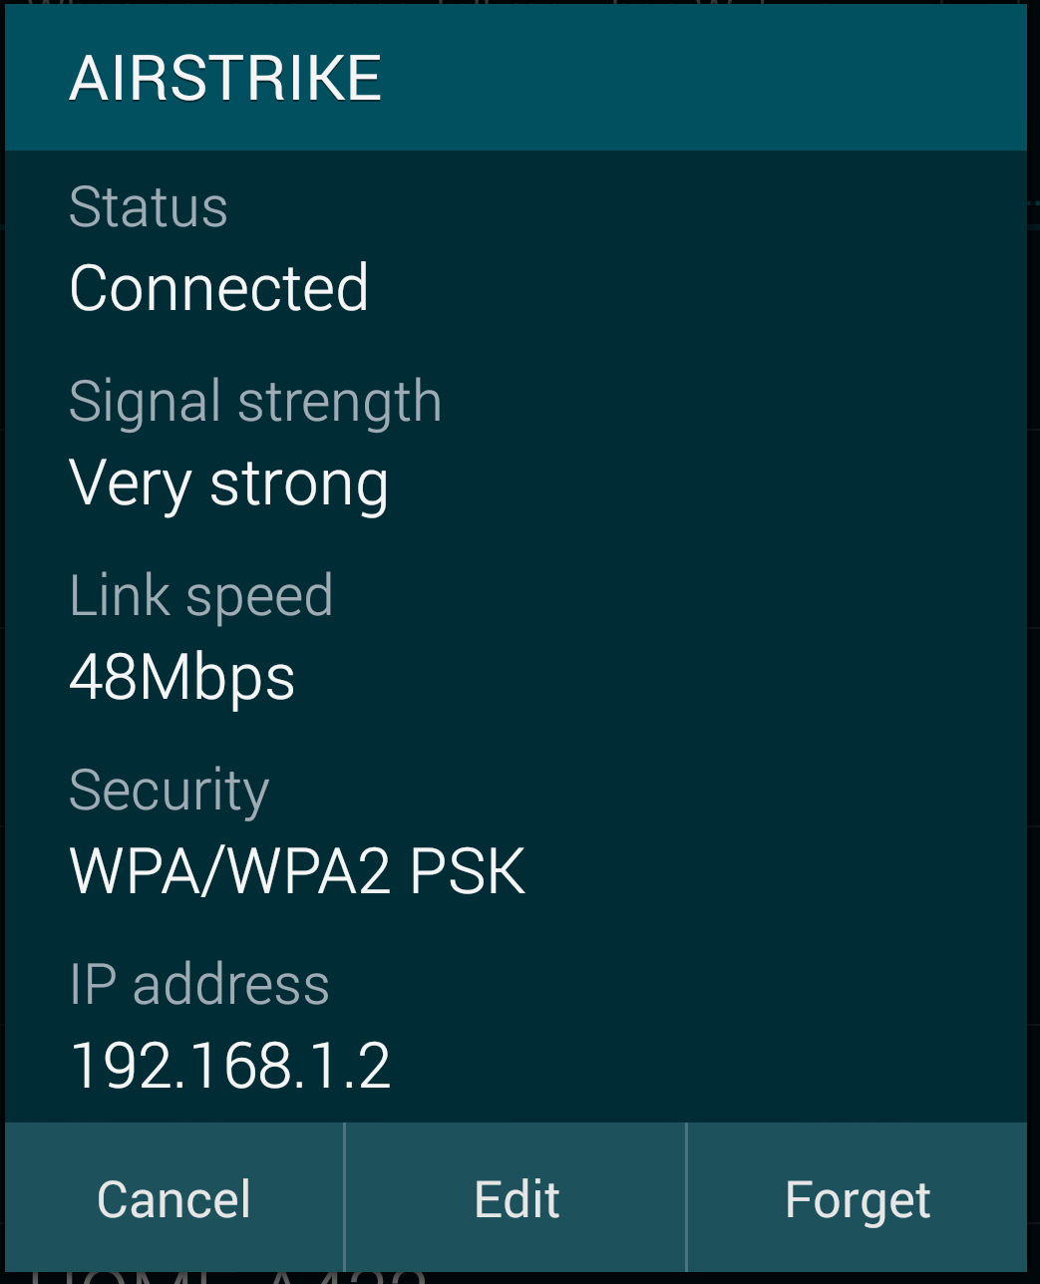
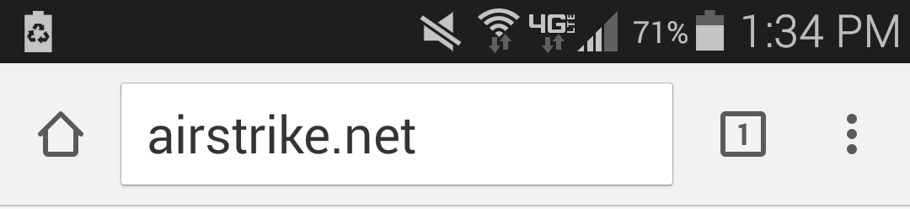
Network User Interface
Through a web browser users can:
  View target information
  View current orientation of turret
  View current laser level
  Set laser power level
  Set target range
  Set configuration information
  Set operation mode

Slide 19
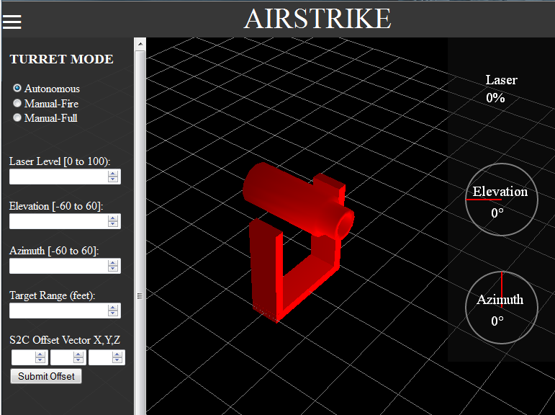
Network User Interface (continued)
Takes advantage of HTML5
  Scene rendered in WebGL
  WebSockets for fast communication
  Canvas objects for 2D diagrams

Slide 20
Vision System

Slide 21
Camera
Chose Pixy (CMUCam5)
  Built in image processing
  Detects color blobs and transmits
  coordinates
  Communicates via SPI, I2C, UART,
  and more
  75° horizontal view, 47°vertical
  50 frames per second
  (while processing)

Slide 22
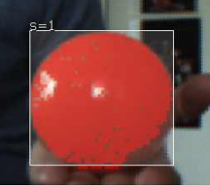
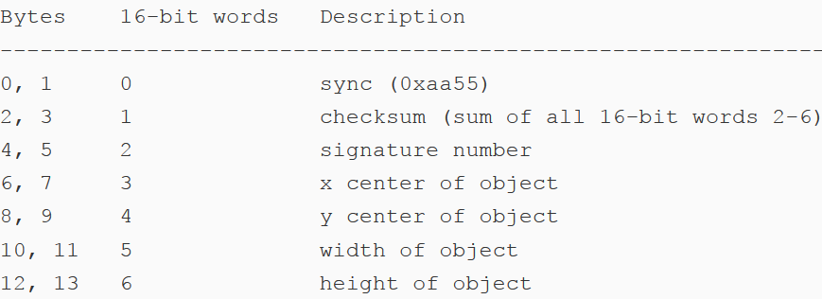
Communicating with Pixy
Communicate via SPI
  Faster than other methods
Big Endian, 16-bit words
Sends data every 20 ms
Frames separated by two sync words

Slide 23
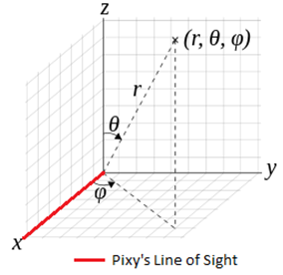



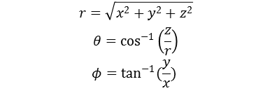

Line of Sight Transformations
Need to convert the coordinates Pixy provides into a line of sight vector that will aim our gimbal system at our designated target.
$$d=\left(1+k_{1}r^{2}+k_{2}r^{4}\right)$$
$$x^{′}=d∗x$$
$$y^{′}=d∗y$$
$$x=r∗\sin\left(θ\right)∗\cos\left(φ\right)$$
$$y=r∗\sin\left(θ\right)∗\sin\left(φ\right)$$
$$z=r∗\cos\left(θ\right)$$
$$\vec{α_{j}}=\frac{\vec{D_{j}}}{\vec{P_{j}}}$$
$${\vec{a}}^{′}=\vec{a}+\vec{s}$$
$$r=\sqrt{x^{2}+y^{2}+z^{2}}$$
$$θ=\cos^{−1}\left(\frac{z}{r}\right)$$
$$φ=\tan^{−1}{(\frac{y}{x})}$$

Slide 24
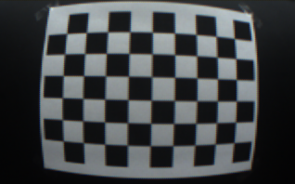
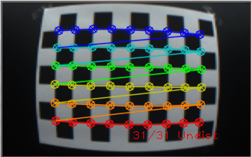
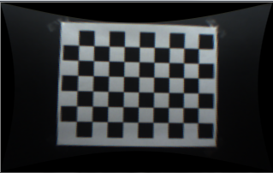

Radial Distortion
Due to the properties of Pixy’s camera lens, images used for processing had barrel distortion, and thus when we converted pixels to degrees the results were incorrect.
We utilize Brown-Conrady model to remove distortion from image
Brown-Conrady coefficients (k₁, k₂) calculated with checkered board and OpenCV.
$$x^{′}=\left(1+k_{1}r^{2}+k_{2}r^{4}\right)∗x$$
$$y^{′}=\left(1+k_{1}r^{2}+k_{2}r^{4}\right)∗y$$

Slide 25
Targeting Thread - Tracking
Pixy is a simple detector
  Built in image processing does not track anything but merely reports its detections
We use tolerances to search detection list for already found target based on distance tolerance
  Closest object to previous location chosen
  If no object is found within our tolerance, we wait a defined number of frames to see if it’s picked back up
  Keep count of viable frames of data in order to determine confidence
    Needed to decide when to fire laser
  Velocity computed, but not entirely usable due to servo refresh rate being the same as Pixy’s frame rate
    Currently pushes the servo to where the object should be
    when the Servo’s next refresh

Slide 26
PCB Design

Slide 27
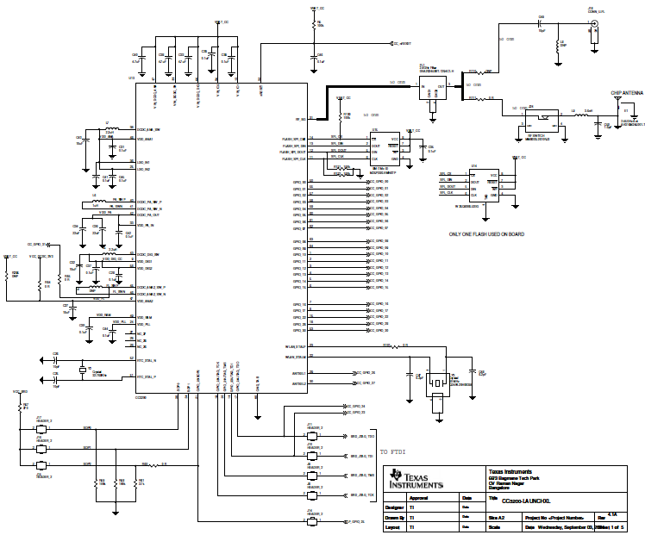
MCU Design/Schematics
CC3200 MCU

Slide 28
MCU Design/Schematics
Networking Portion of CC3200

Slide 29
MCU Design/Schematics
32.768 KHz Crystal for Real Time Processing
40 MHz Crystal for Internal Processing

Slide 30
MCU Design/Schematics
All GPIO ports

Slide 31
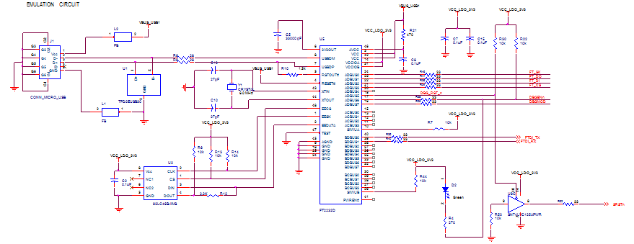
MCU Design/Schematics
FT2232D Debugger

Slide 32
MCU Design/Schematics
Micro USB Input

Slide 33
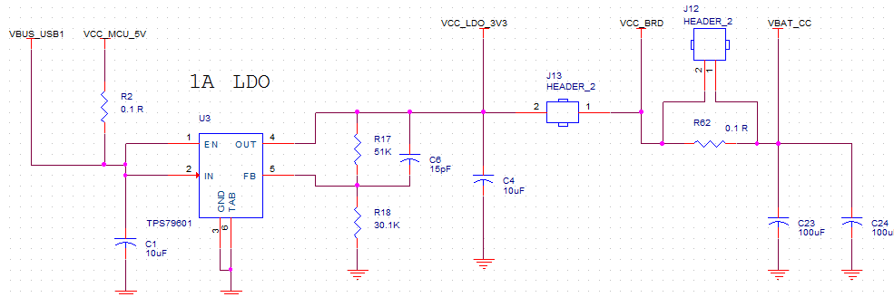
MCU Design/Schematics
TPS79601DCQR
Voltage Regulator

Slide 34
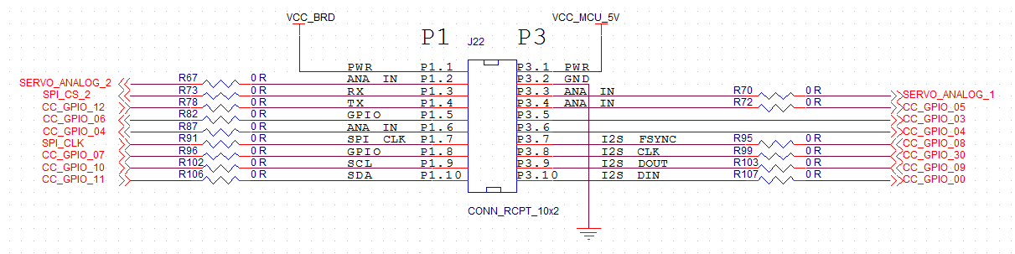
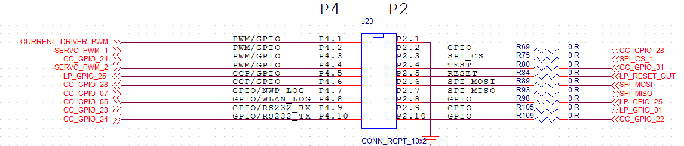
MCU Design/Schematics

Slide 35
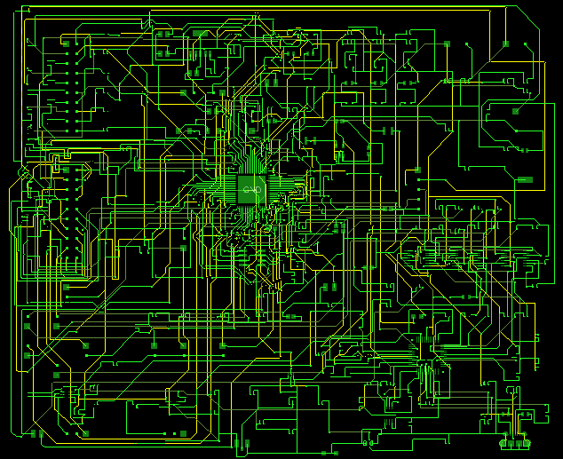
MCU Design/Board Layout

Slide 36
Directed Energy

Slide 37
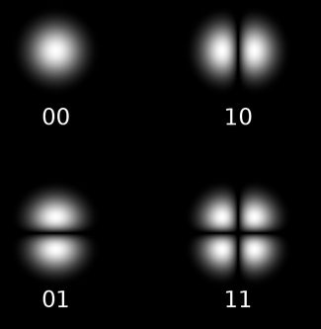
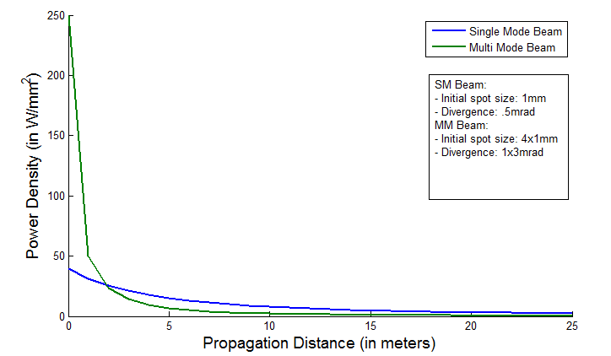
Directed Energy System
The DE component will generate a high energy, coherent light beam to eliminate targets
Wide range of laser diodes available
  Narrowed down to 405nm and 808nm wavelength LDs
  Single Mode vs Multi Mode output
    Single mode preferable, however for power output >500mW, MM is the only option

Slide 38
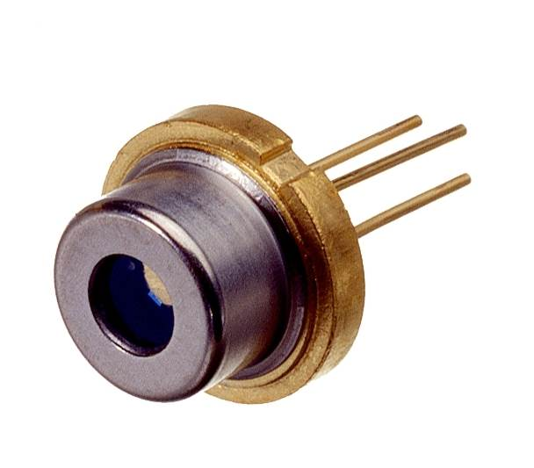
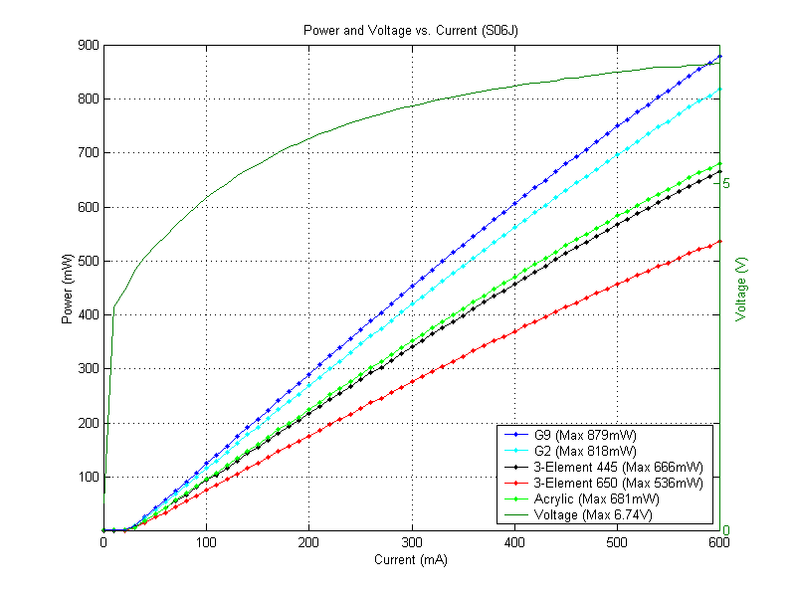
Diode Characteristics
S06J diode rated for 625mW at 450 mA
Emits at peak wavelength of 405nm

Slide 39
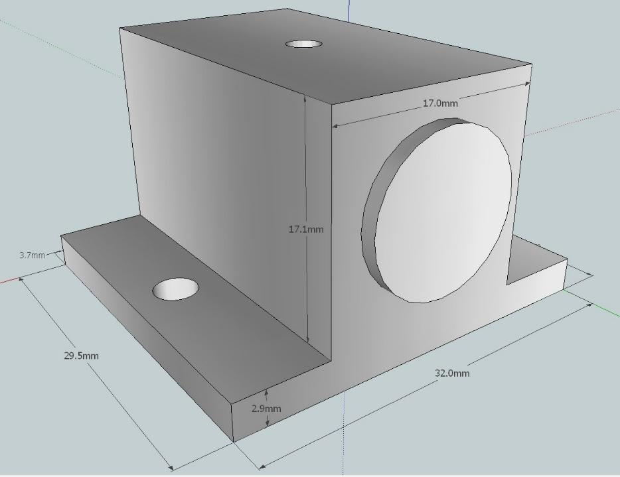
Components
Collimating Optics- Light emitted from LD is highly diverging
  Proper optics required to capture majority of light and collimate for high efficiency operation
Proper cooling required for maximize lifetime of LD
  The high thermal conductivity of copper makes it an ideal choice for material
θ

Slide 40
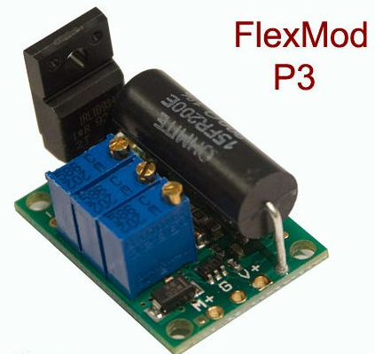
Power Delivery
The LD will be powered by a Flexmod P3 current driver
  Flexmod will receive PWM signals from the MCU to determine the current to provide the LD
Two operating lasing modes:
  Low power mode- Driver will supply 10mA giving < 10mW optical power
  High power mode- Driver will supply 450mA giving 600mW optical power

Slide 41
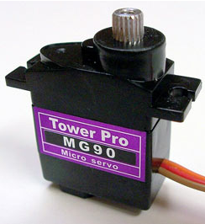
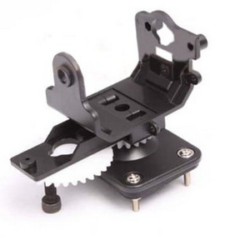
2-Axis Gimbal
TP GM90 Metal Gear Servos
  Same size as 9g nylon gear servo
  Metal gearing offers high torque figures to compensate for additional weight of heat sink
Specifications
  Torque: 4.8/6 V= 2.2/2.5 kg/cm
  Speed: 4.8/6 V=.11/.1 sec/60degree
  Rotation Range: 180°
  Driven by PWM: 400-2400μs pulse
Gimbal assembly is a modified Boscam camera gimbal

Slide 42
Power PCB Design

Slide 43
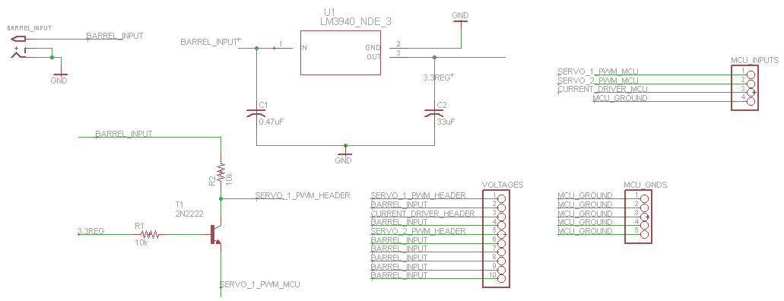
Power Design/Schematics

Slide 44
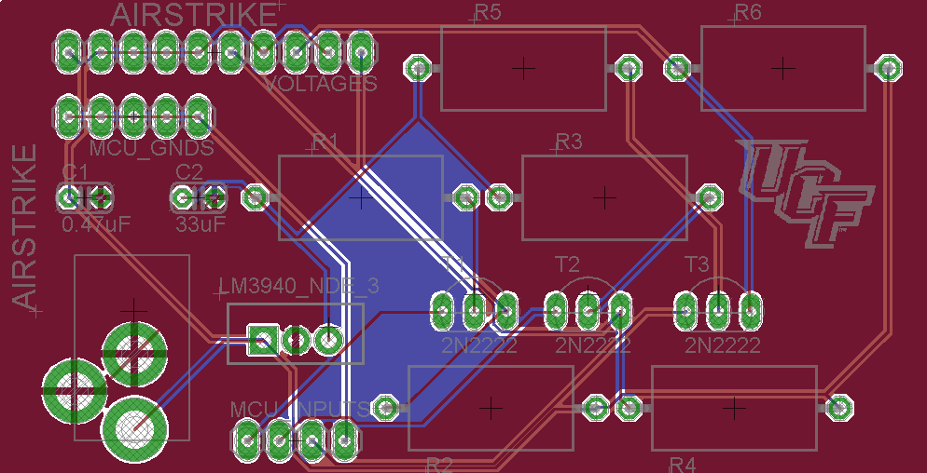
Power Design/Board Layout

Slide 45
Administrative Content

Slide 46
Work Distribution
Name | Software | Camera | Network | Laser | Servos | PCB | Power | Housing
Kevin | X |  | X
Scott |  |  |  |  |  | X | X | X
Andrew |  |  |  | X | X |  | X | X
Chris | X | X

Slide 47
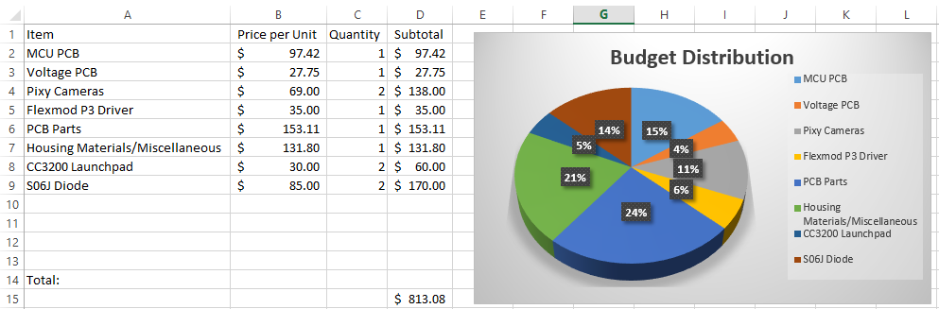
Budget Distribution
Funded by Boeing: $900

Slide 48
Issues
Debugging PCB
Due to timing issues with SPI Slave Select with CC3200, we were unable to get two Pixys communicating on the same SPI channel with our MCU
Laser Diode is to bright and can alter the color of targets, confusing Pixy
Due to lack of real time-keeping capabilities and slow refresh rate of servos, tracking quite difficult
Custom web server can’t take full advantage of network processor so threads don’t execute as fast and is limited to one active connection to conserve resources.

Slide 49
Questions?

Slide 50
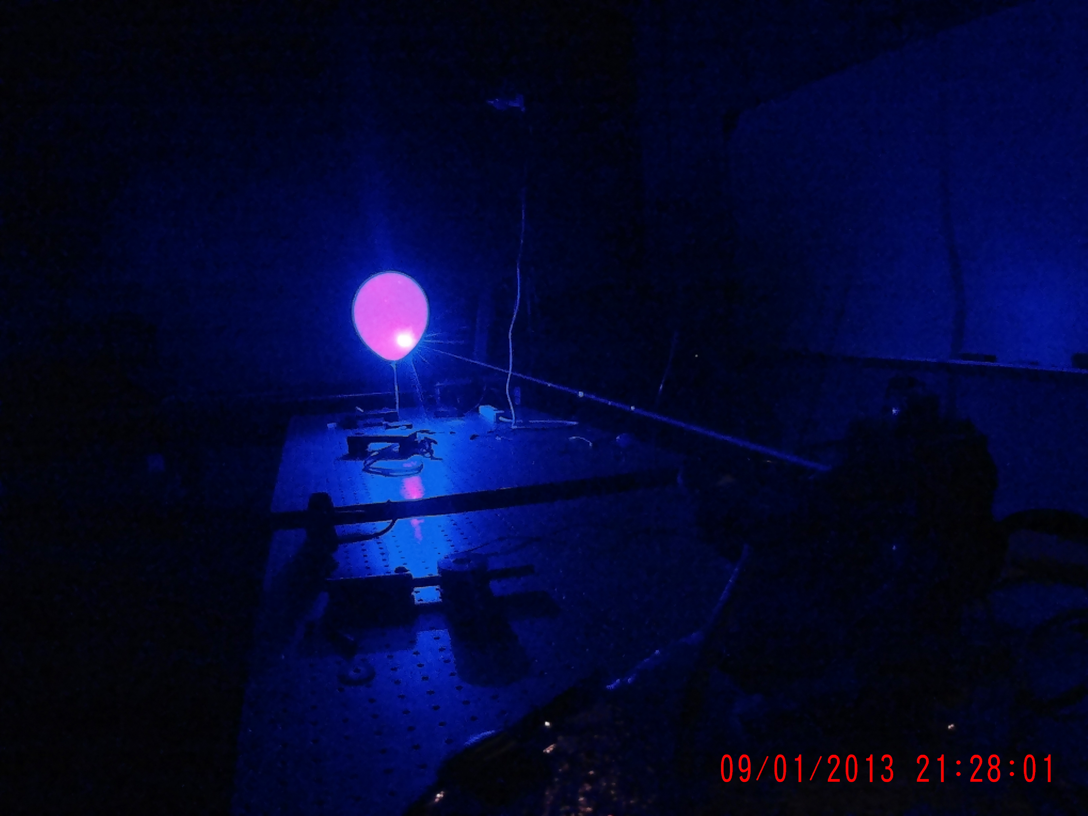
AIR-STRIKE VIDEO DEMO

Slide 51
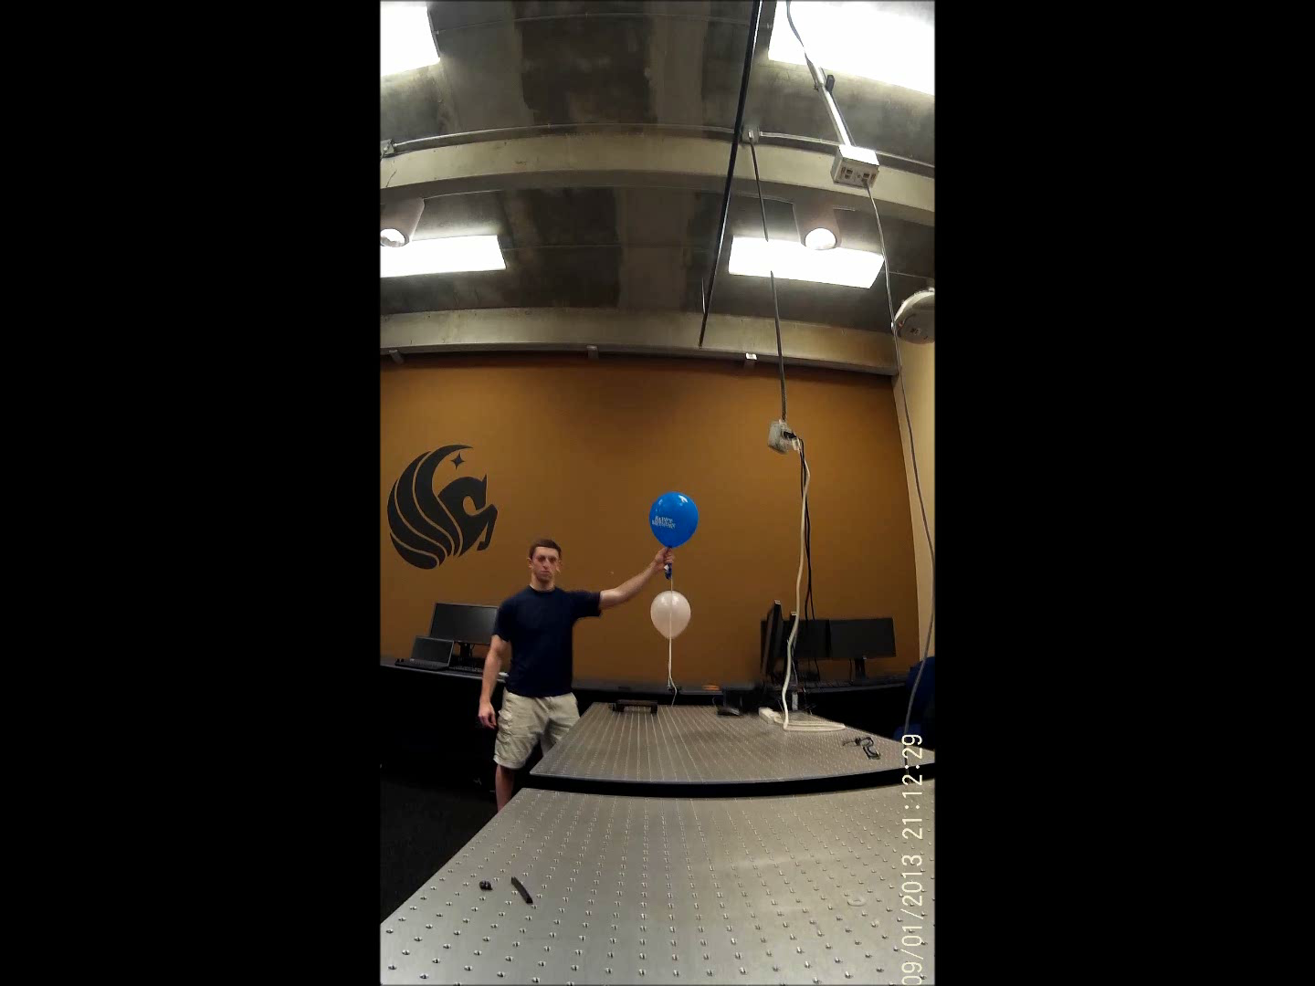
Trial 1:

Slide 52
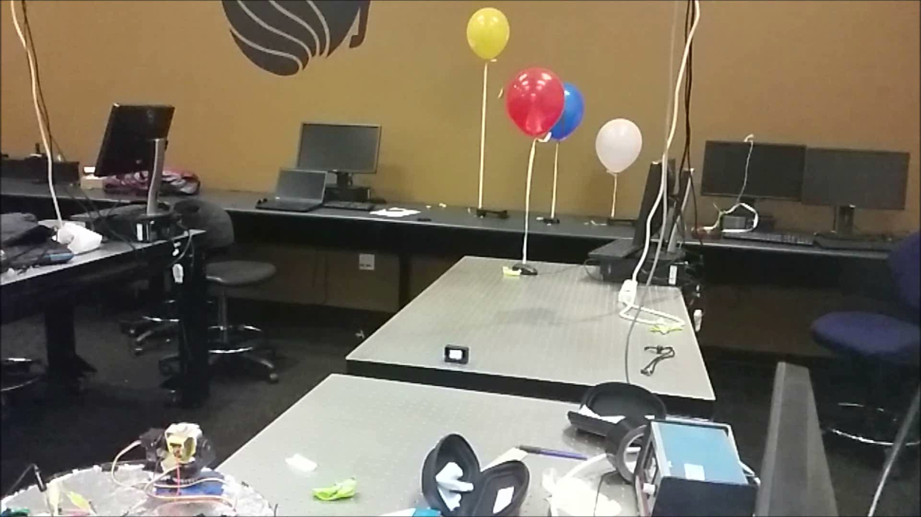
Trial 2:

Slide 53
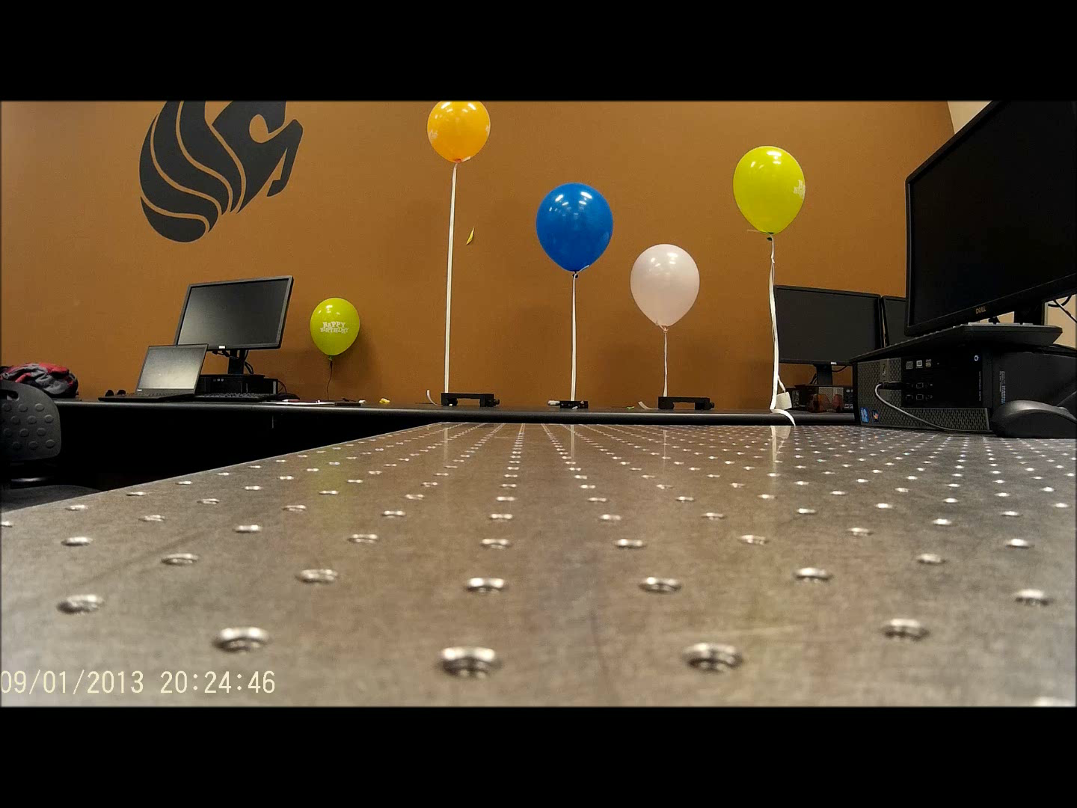
Trial 3:

Slide 54
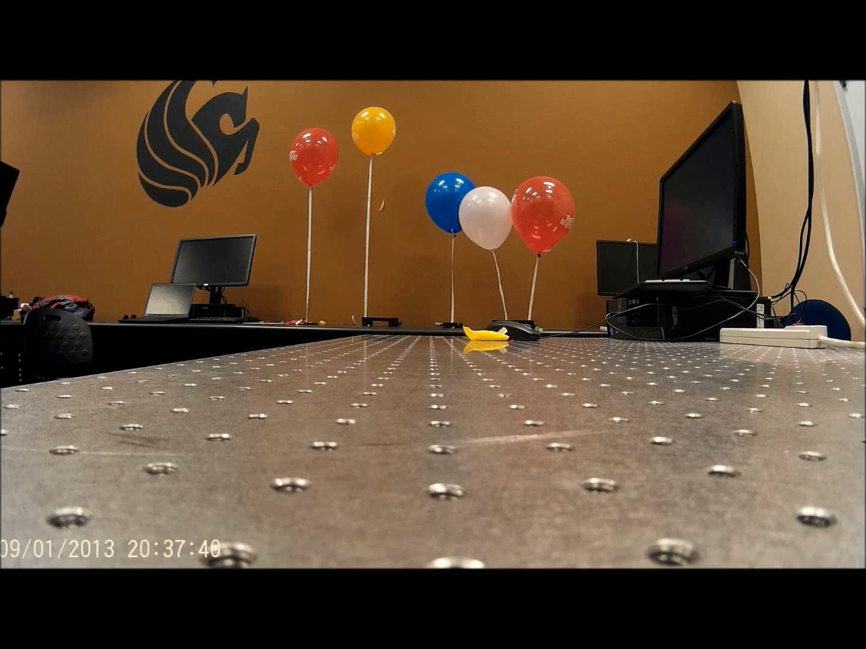
Trial 4:

Slide 55
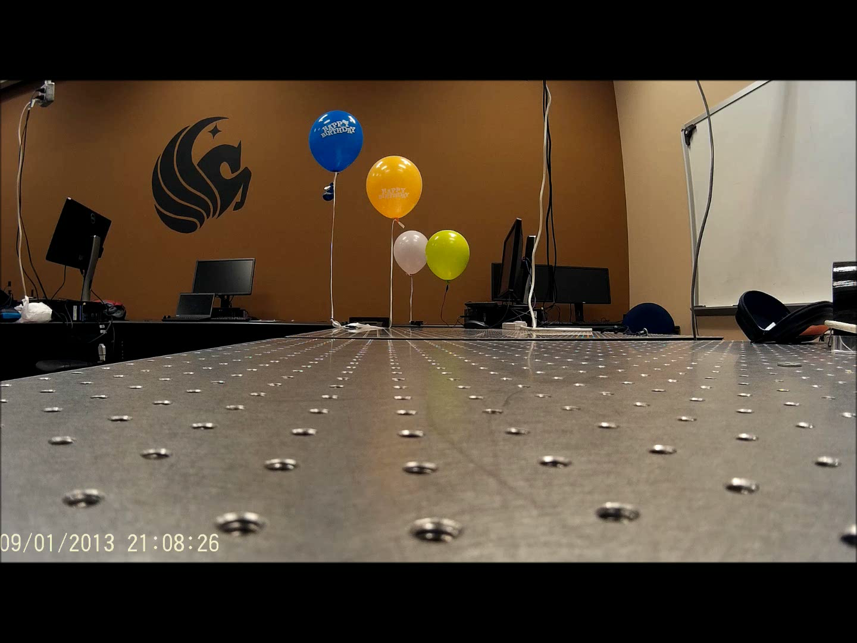
Trial 5:

Slide 56
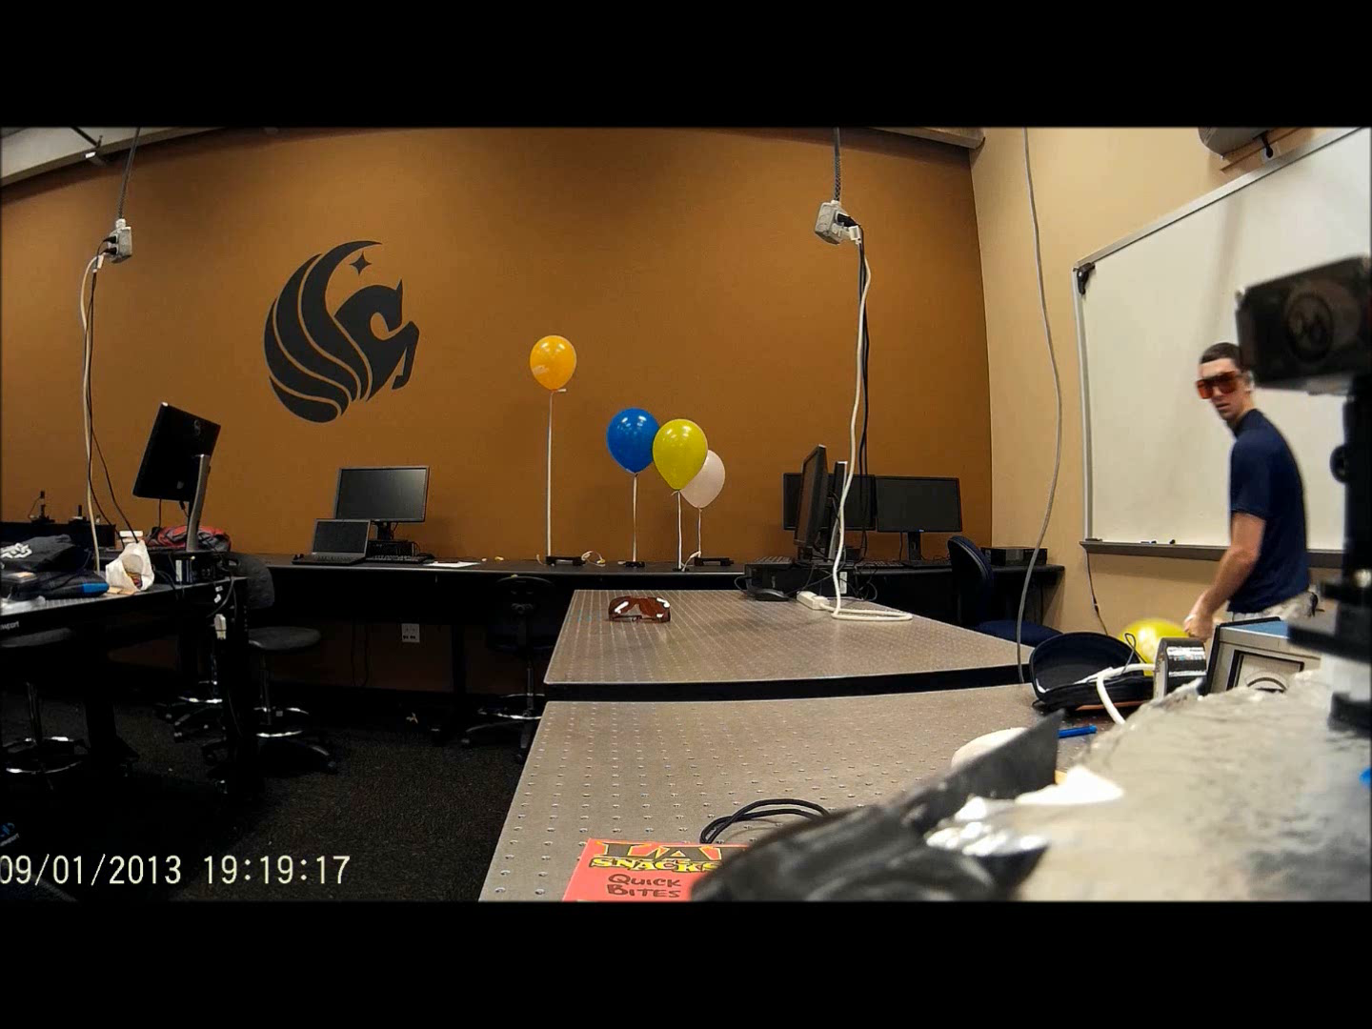
Trial 6:

Slide 57
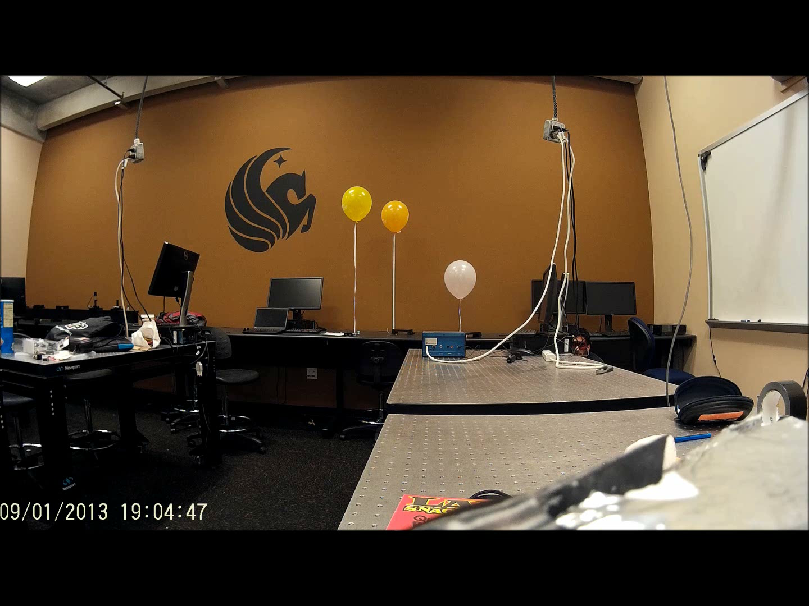
Trial 7:

Slide 58
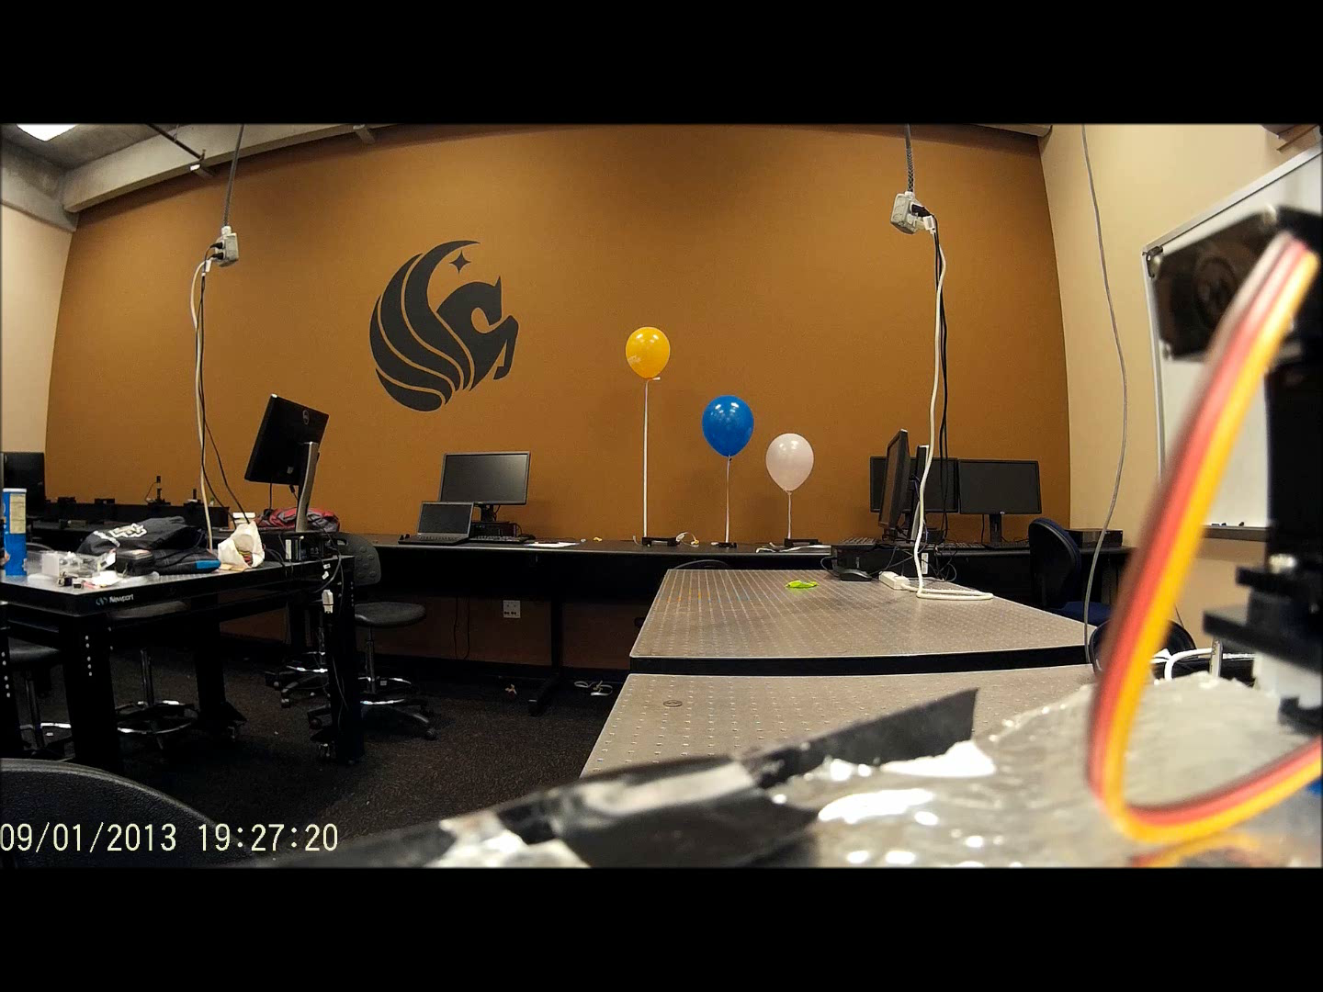
Trial 8:

Slide 59
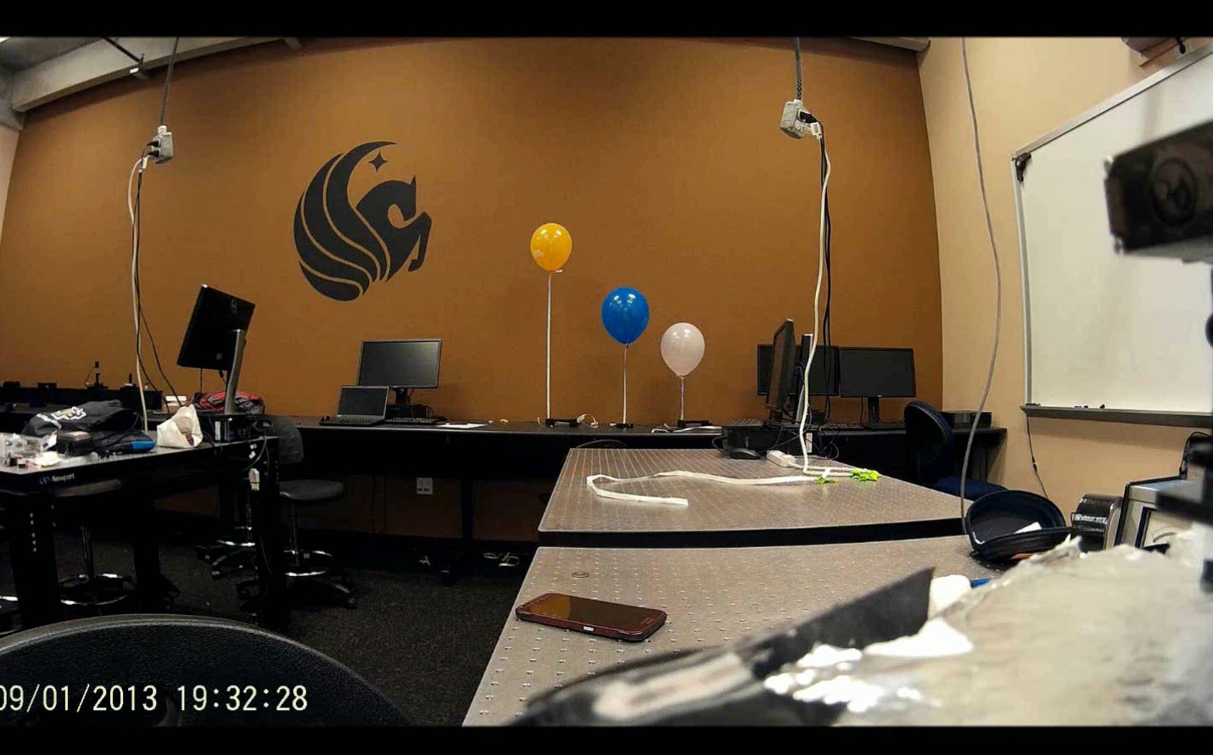
Trial 9:

Slide 60
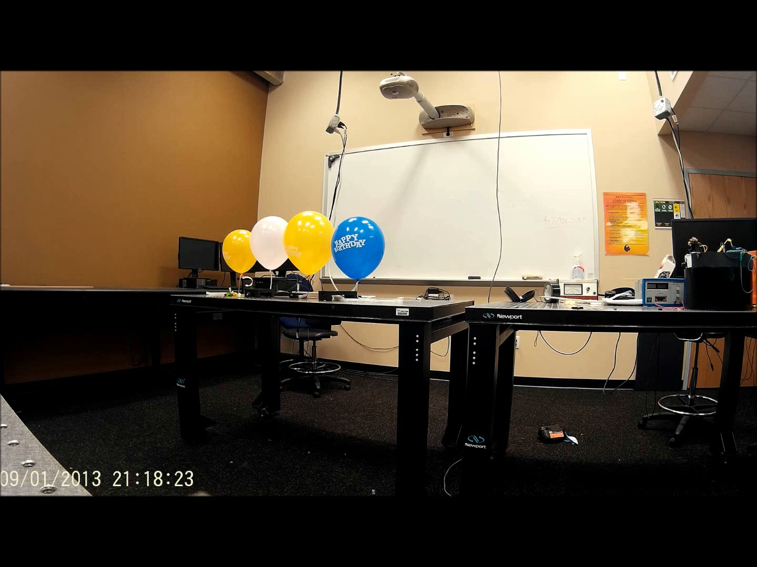
Trial 10:

Slide 61
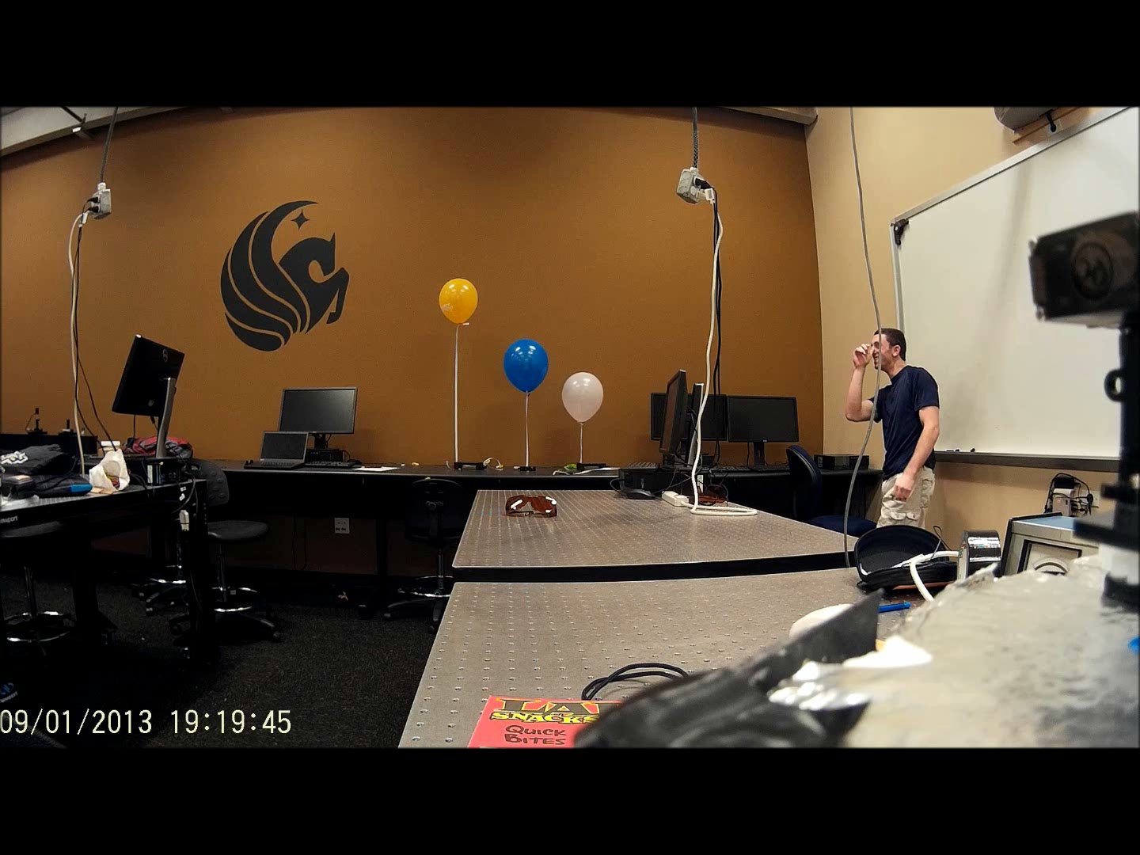
And a whole lot of this!

